Slide 1

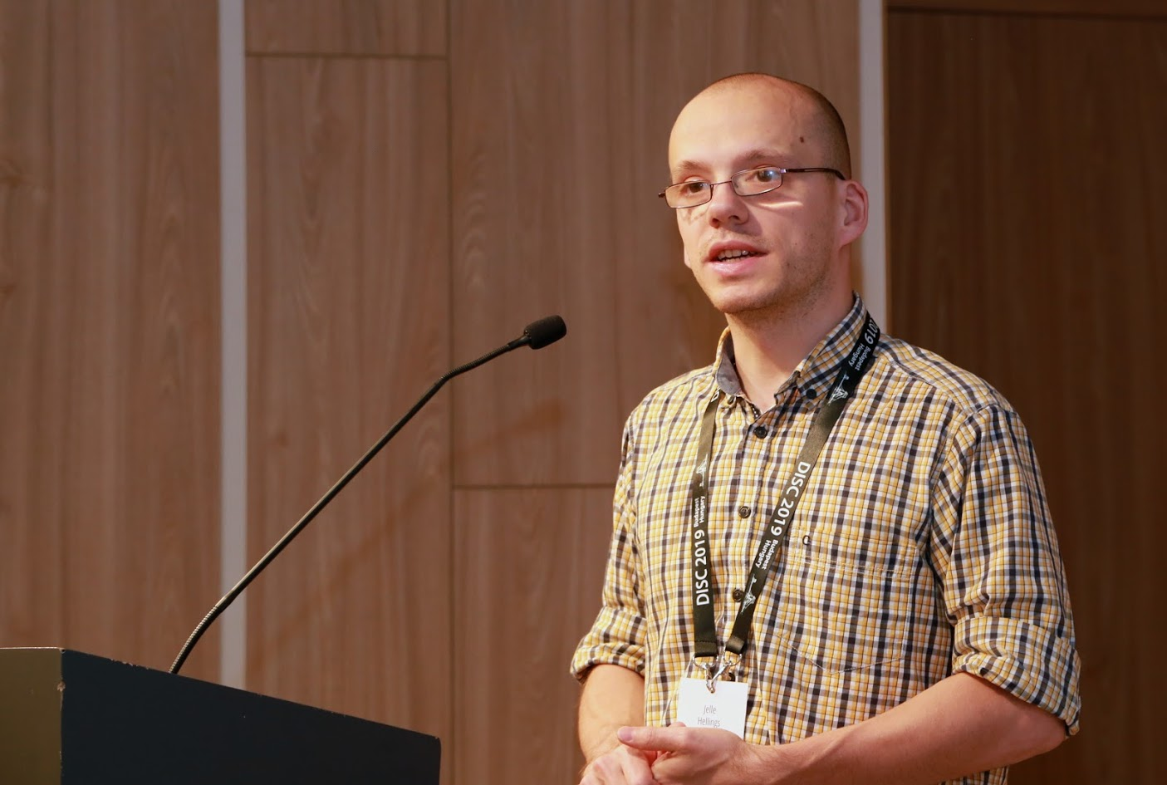


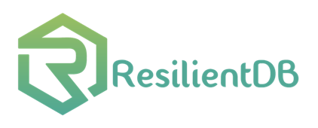
Scaling Blockchain Databases through Parallel Resilient Consensus Paradigm
Suyash Gupta
Jelle Hellings
Mohammad Sadoghi
Exploratory Systems Lab
University of California Davis

Slide 2
Journey…
Efficient Commitment in Partitioned (Sharded) Databases.
EasyCommit [EDBT’18] → Two-Phase Non-Blocking Commit Protocol.
GeoScale EasyCommit [Distributed and Parallel Databases (DAPD) 2020]
Efficient Concurrency Control in Partitioned Databases.
QStore [EDBT’20] → Queued approach for distributed concurrency control.

Slide 3
Journey…
Efficient Two-Phase Byzantine-Fault Tolerant (BFT) Consensus Protocol
Proof-of-Execution [arxiv]
No twin-paths, no dependence on clients, no trusted component
Can employ both asymmetric and symmetric cryptographic signatures.
Efficient Global-Scale BFT Consensus Protocol
GeoBFT [VLDB’20] → Topology aware clustering
Throughput of order 50Ktxns/s among replicas across continents.

Slide 4






At the core of any Blockchain application is a Byzantine Fault-Tolerant (BFT) consensus protocol.
Client
Crashed
Primary
Malicious

Slide 5
Existing BFT Protocols: Primary-Backup
Primary leads the consensus and backups follow!
Ex: PBFT [SOSP’98], Zyzzyva [SOSP’07], SBFT [DSN’19].
If primary is faulty → needs to be replaced!
Primary replacement is expensive.
If primary is malicious → can throttle throughput and remain undetected.

Slide 6
Existing BFT Protocols: Rotating Primary
How about frequently change primary?
Aardvark [NSDI’09], Prime [TDSC’10] and Spin [SRDS’09].
Still essentially single primary!
How about change primary for each consensus?
Inherently sequential.

Slide 7
Our Proposal
Democracy → Give all the replicas the power to be the primary.
Parallelism → Run multiple parallel instances of a BFT protocol.
Decentralization → Always there will be a set of ordered client requests.
Multiple Byzantine Fault-Tolerance Paradigm

Slide 8
MultiBFT Paradigm
Parallelism
Ordering
Execution
BFT protocol
Run z parallel BFT
instances.
Create a global order
of all the requests.
Execute the requests
in a global order.
Number of
Instances (z)

Slide 9
Client
T
1
Primary
Replica
2
1
Replica
2
Client
T
Primary
Replica
1
2
Byzantine
Replica
1
2
Request
Pre-Prepare
Prepare
Commit
Reply
MultiBFT using PBFT with 2 parallel instances.

Slide 10

Challenges?
How to securely order the requests?
Does failure of one instance causes other instances to stop?
Can there be continuous ordering of requests?
How to fend against coordinated attacks?

Slide 11




Secure Ordering
transfer(A,B,m,n) → if
bal(A) > m
then
bal(A) = bal(A) – m;
bal(B) = bal(B) + n;
bal(Alice) = 600
bal(Bob) = 300
Alice
Bob
T1: transfer(Alice, Bob, 500, 200)
T2: transfer(Bob, Eve, 400, 300)
Eve

Slide 12
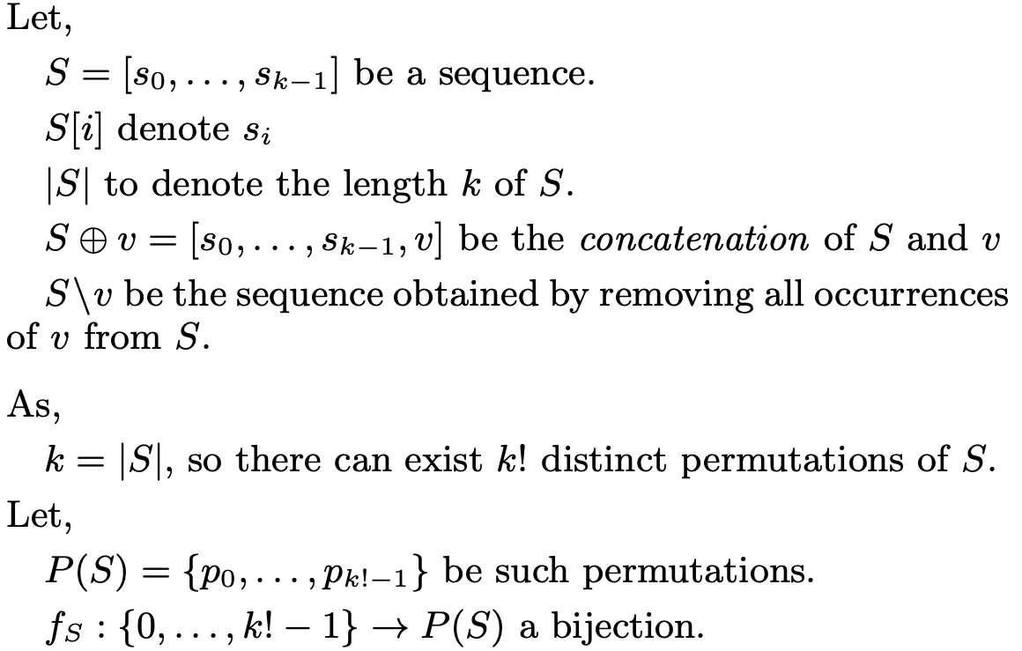
Secure Ordering Solution

Slide 13
Secure Ordering Solution

Slide 14
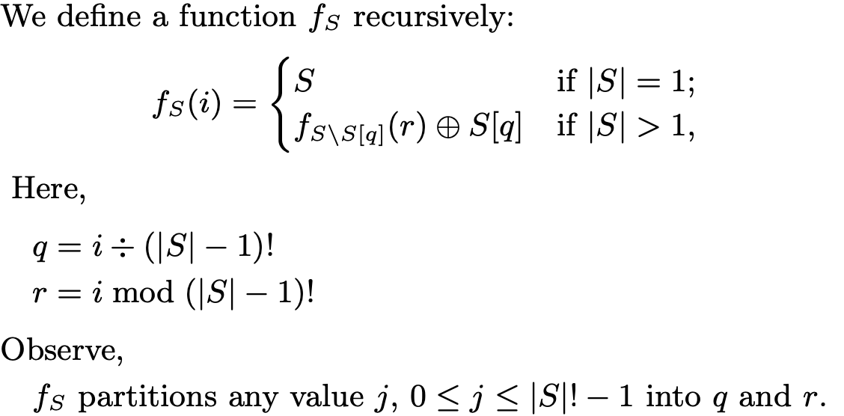
Secure Ordering Solution

Slide 15
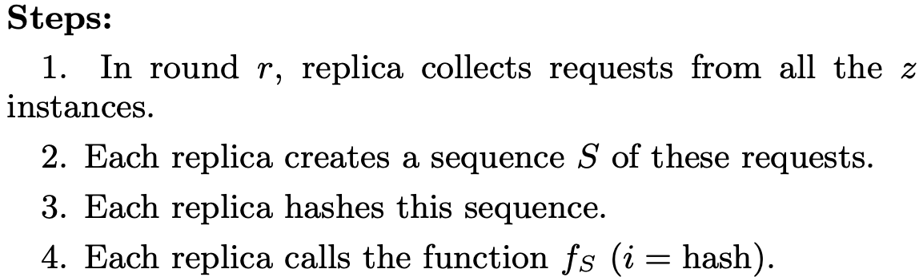
Secure Ordering Solution

Slide 16
Malicious Primaries Collusion
Multiple malicious primaries can prevent liveness!
Good Replicas
|A| = f
Good Replica
|C| = 1
Good Replicas
|B| = f
m₁
m₂
P₁
|M| = f
P₂
Other f-2
Malicious Replicas

Slide 17
ResilientDB: High Throughput Yielding, Scalable Permissioned Blockchain Fabric*
Visit at: https://resilientdb.com/
*Proceedings of the 40th IEEE ICDCS 2020.

Slide 18
Why Should You Chose ResilientDB?
Bitcoin and Ethereum offer low throughputs of 10 txns/s.
Existing Permissioned Blockchain Databases still have low throughputs (20K txns/s).
Prior works blame BFT consensus as expensive.
System Design is mostly overlooked.
ResilientDB adopts well-researched database and system practices.

Slide 19
Dissecting Existing Permissioned Blockchains
Single-threaded Monolithic Design
Successive Phases of Consensus
Integrated Ordering and Execution
Strict Ordering
Off-Chain Memory Management
Expensive Cryptographic Practices

Slide 20
Can a well-crafted system based on a classical BFT protocol outperform a modern protocol?

Slide 21
ResilientDB Architecture
SECURE
LAYER
EXECUTION LAYER
THREADS
SIGNING
TOOLKIT
QUEUES
NET WORK
HASHING
TOOLKIT
BFT CONSENSUS
STORAGE LAYER
METADATA
BLOCKCHAIN

Slide 22
ResilientDB Multi-Threaded Deep Pipeline
Network
Network
Client
Requests
Input
Batch Creation
Output
Message from
Clients and Replicas
Prepare
& Commit
Message to
Replicas and Clients
Worker
Execute
Checkpoint
22

Slide 23
Evaluating MultiBFT on ResilientDB

Slide 24
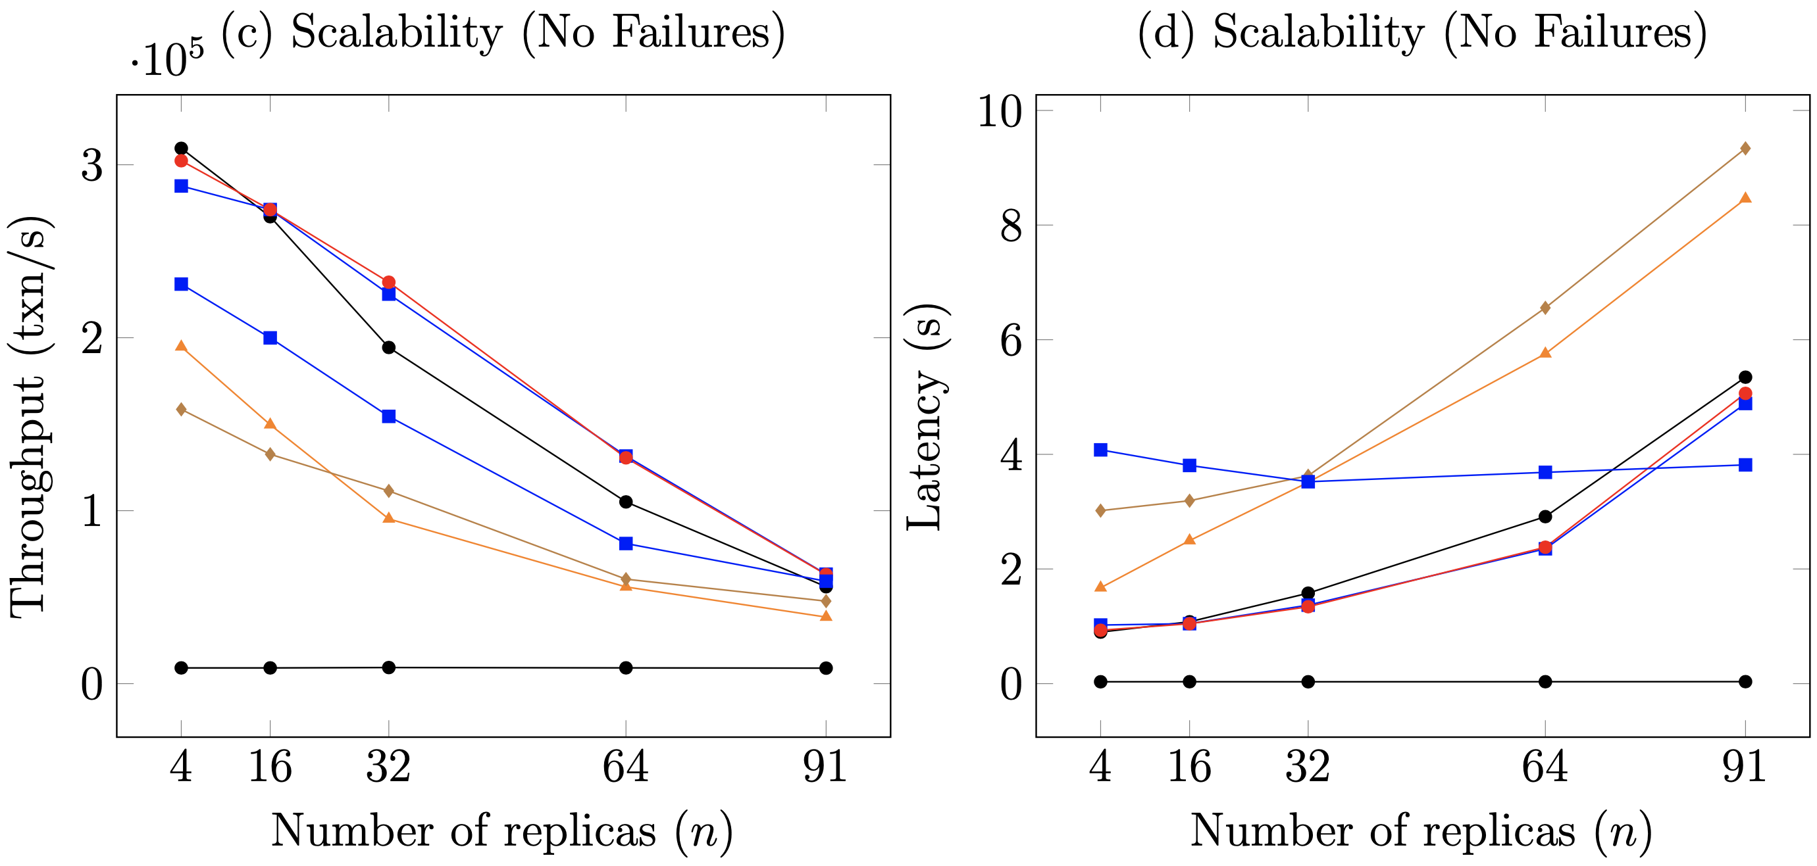
Scalability

Slide 25
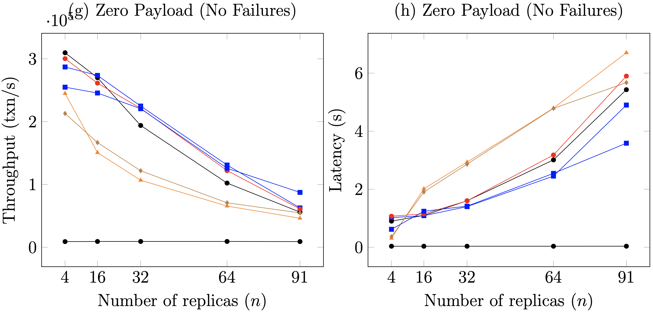
Zero Payload

Slide 26
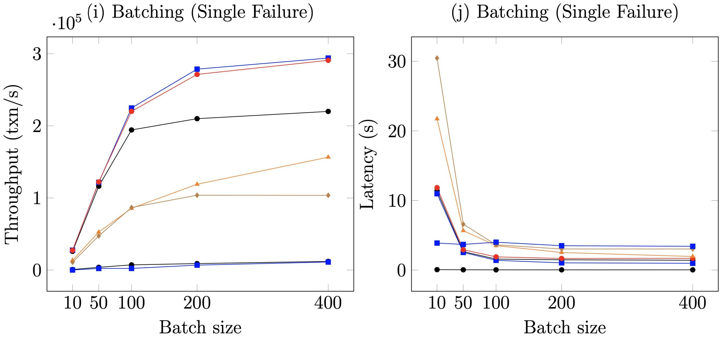
Batching

Slide 27
Thank You

